Slide 1
Vcare
vf
Team :
(063) Shruti Dikkar
(064) Srushti Patil
(068) Dhananjay Mane
(061) Anshu Dudhgundi

Slide 2
Table of contents
01
02
03
Problem Statement
Introduction
Need of system
04
05
06
Motivation
Requirement
Architecture

Slide 3
Problem Statement
In this busy world we don’t have the time to wait in infamously long hospital queues. The problem is, queuing at hospital is often managed manually by administrative staff, then take a token there and then wait for our turn then ask for the doctor and the most frustrating thing - we went there by traveling a long distance and then we come to know the doctor is on leave or the doctor can’t take appointments.

Slide 4
Introduction
Vcare is the website for doctors and patients .
In which there will be two dashboards for doctors and patients.
The doctors with different specializations can login to the website
Patients can visit the website and identify their illness .
And also book the appointment with there prefered doctor.
Time slot will be given to the patient according to the doctor availability.

Slide 5
NEED OF SYSTEM
Medical care has several important functions other than restoring or maintaining health. These other functions are
assessment and certification of health status, prognostication, segregation of the ill to limit communication of illness, and helping to cope with the problems of illness--the caring function.
Doctors are responsible for increased life expectancy and
improved well-being in society.

Slide 6
MOTIVATION
The real motivation for the project is to make easy process of all the management process like patients registration, billing, doctors appointment, doctors prescription, etc. We always see that to find out the patient’s history, the user has to go through various registers. This results in wastage of time. So by this system it will become easy to manage all process. So now by taking the motivation of this scenario which was regularly done in hospitals we are designing this system which can be benefited for the patients and hospital staff. So, we'd like to possess this system which help hospital to do work fast and effective.

Slide 7
Requirements
SOFTWARE
HARDWARE
Processor | Pentium IV, i3, i5, i7
HDD | 20 GB min
RAM | 1 GB Min
Keyboard | Standard 102 keys
Frontend | HTML , CSS, Javascript
Backend | PHP
Database | Mysql
IDE | Visual Studio

Slide 8
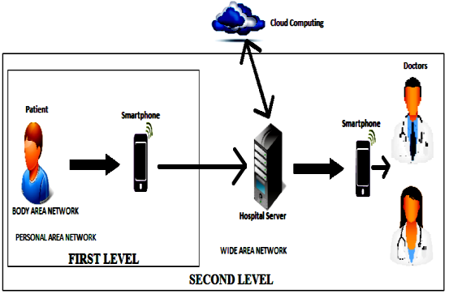
2 TIER ARCHITECTURE

Slide 9
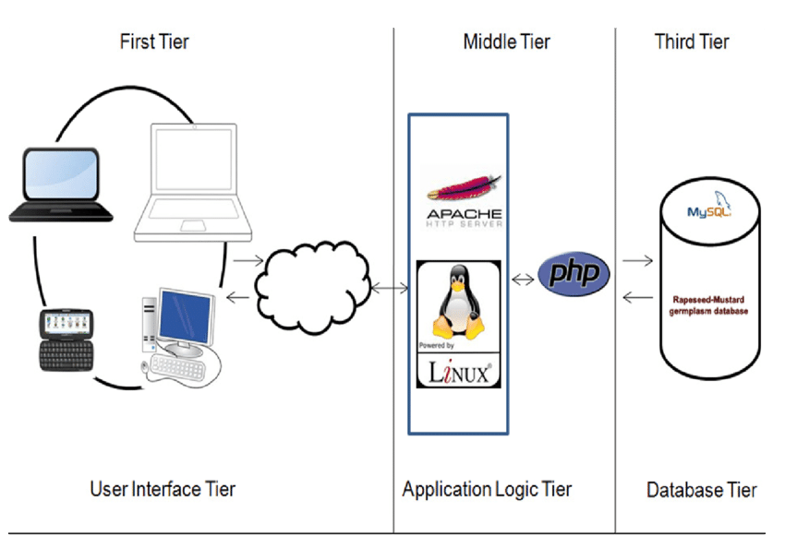
3 TIER ARCHITECTURE

Slide 10
Thank you!
.

